Slide 1

C++: Memory Management
Presenter: Dr. Ha Viet Uyen Synh.

Slide 2
Overview
4 major memory segments
Global: variables outside stack, heap
Code (a.k.a. text): the compiled program
Heap: dynamically allocated variables
Stack: parameters, automatic and temporary variables
Key differences from Java
Destructors of automatic variables called when stack frame where declared pops
No garbage collection: program must explicitly free dynamic memory
Heap and stack use varies dynamically
Code and global use is fixed
Code segment is “read-only”
stack
heap
code
global

Slide 3
Illustrating C++ Memory
int g_default_value = 1;
int main (int argc, char **argv) {
int *f = new int;
*f = g_default_value;
delete f;
return 0;
}
crt0
main
Foo *f
stack
Foo:
setValue
Foo *this
int v
m_value
heap
code
g_default_value
global

Slide 4
Memory, Lifetimes, and Scopes
Temporary variables
Are scoped to an expression, e.g., a = b + 3 * c;
Automatic (stack) variables
Are scoped to the duration of the function in which they are declared
Dynamically allocated variables
Are scoped from explicit creation (new) to explicit destruction (delete)
Global variables
Are scoped to the entire lifetime of the program
Includes static class and namespace members
May still have initialization ordering issues (Singleton Pattern)
Member variables
Are scoped to the lifetime of the object within which they reside
Depends on whether object is temporary, automatic, dynamic, or global
Lifetime of a pointer/reference can differ from the lifetime of the location to which it points/refers

Slide 5
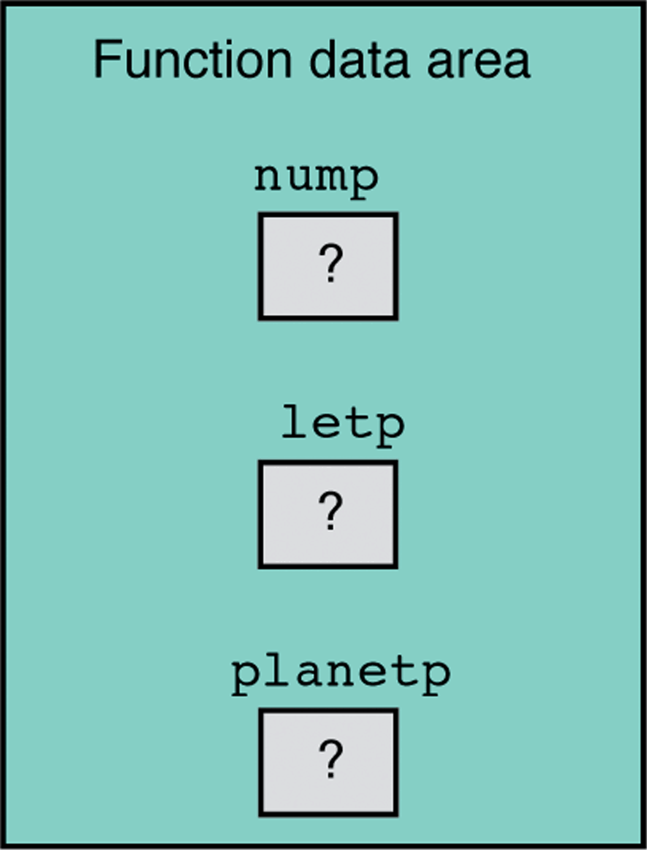
Dynamic memory allocation in C (1/3)
void some_function () { int *nump; char *letp; planet_t *planetp; …

Slide 6
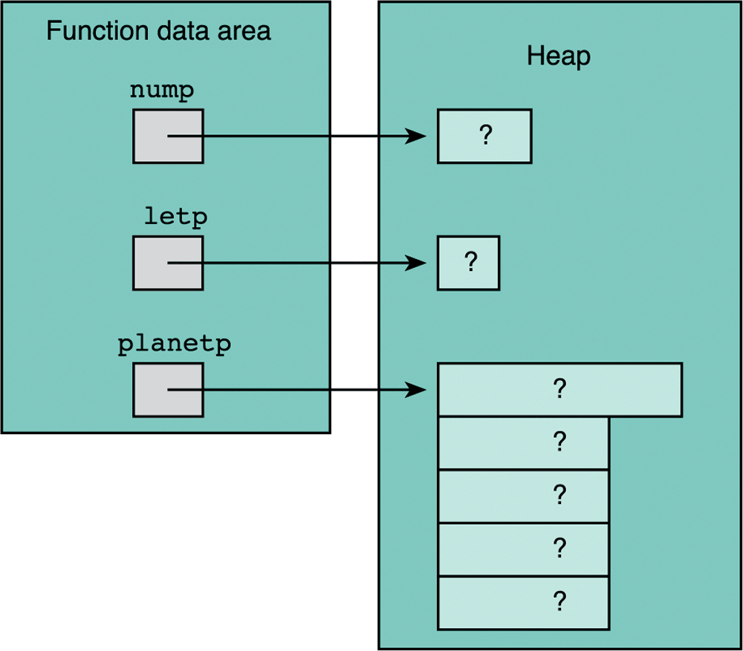
Dynamic memory allocation in C (2/3)
void some_function () { int *nump; char *letp; planet_t *planetp; …
#include <stdlib.h>
nump=(int*) malloc(sizeof(int)); letp = (char*) malloc(sizeof(char)); planetp = (planet_t *) malloc(sizeof(planet_t));

Slide 7
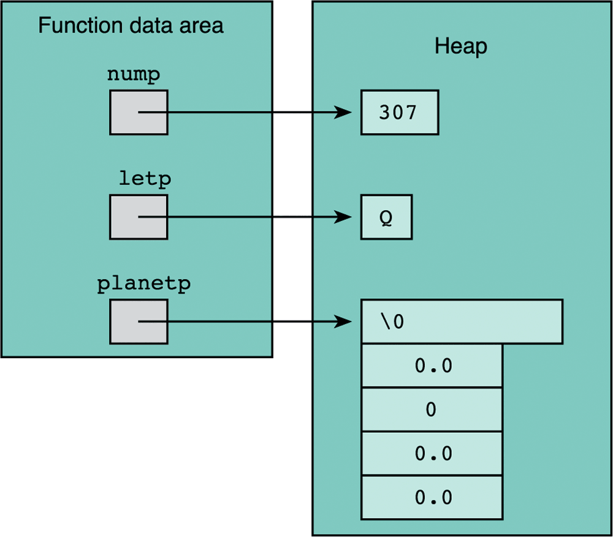
Dynamic memory allocation in C (3/3)
void some_function () { int *nump; char *letp; planet_t *planetp; …
nump=(int*) malloc(sizeof(int)); letp = (char*) malloc(sizeof(char)); planetp = (planet_t *) malloc(sizeof(planet_t));
*nump = 307; *letp = ‘Q’; *planetp = blank_planet;

Slide 8
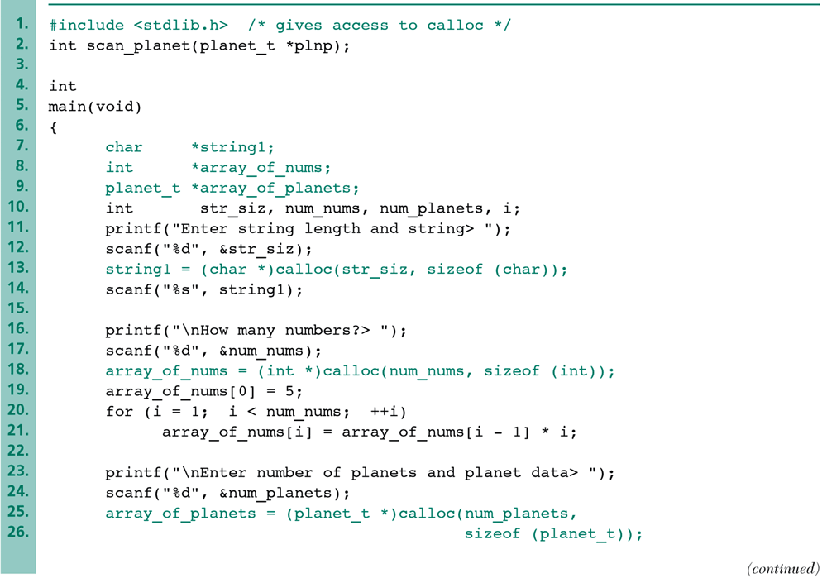
Allocation of Arrays with calloc

Slide 9
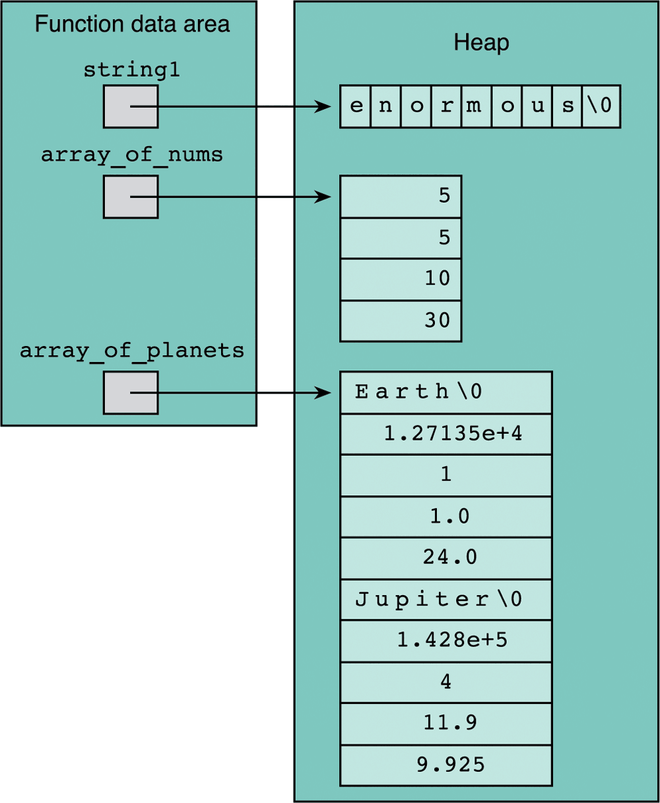
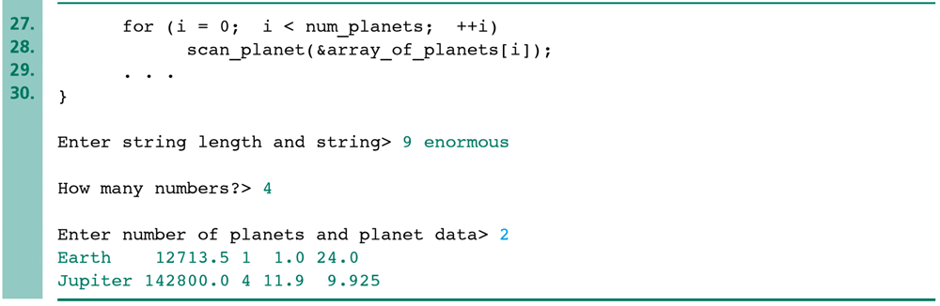
Allocation of Arrays with calloc (cont’d)

Slide 10
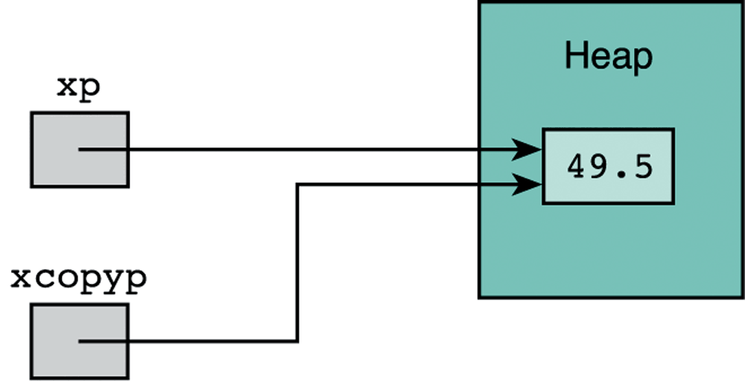
Returning cells to the Heap
… free(letp); free(nump); free(planetp); … free(string1); free(array_of_nums); free(array_of_planets);
double *xp, *xcopyp; xp =(double *)malloc(sizeof(double)); *xp = 49.5; xcopyp = xp; free(xp);
*xcopyp should not be used after it freed or errors can result

Slide 11
Dynamic memory allocation in C++
int *nump; char *letp; planet_t *planetp; char *string1; int *array_of_nums; planet_t *array_of_planets;
nump= new int; letp = new char; planetp = new planet_t; string1 = new char[str_size]; array_of_nums = new int[num_nums]; array_of_planets = new planet_t[num_planets];
delete nump; delete letp; delete planetp; delete [ ] string1; delete [ ] array_of_nums; delete [ ] array_of_planets;

Slide 12
Dynamic Allocation and De-allocation
#include <iostream>
using namespace std;
int main (int, char *[]) {
int * i = new int;// any of these can throw bad_alloc
int * j = new int (3);
int * k = new int[*j];
int * l = new int[*j];
for (int m = 0; m < *j; ++m) {
l[m] = m;
}
delete i;
delete j;
delete [] k;
delete [] l;
return 0;
}
Array vs. single instance new
Fill in array values with loop
Array vs. single instance delete

Slide 13
A Basic Issue: Aliasing
int main (int argc,
char **argv) {
int f;
int *p = &f;
int &r = f;
delete p;
return 0;
}
Multiple aliases for same object
f is a simple alias, the object itself
p is a variable holding a pointer
r is a variable holding a reference
What happens when we call delete on p?
Destroy a stack variable (may get a bus error there if we’re lucky)
If not, we may crash in destructor of f at function exit
Or worse, a local stack corruption that may lead to problems later
Problem: object destroyed but another alias to it was then used
int &r
int f
int *p

Slide 14
Memory Initialization Errors
int main(int argc, char **argv) {
int *f;
cout << *f << endl;
for (int i; i < argc; ++i)
cout << argv [i] << endl;
return 0;
}
Heap and stack memory is not initialized for us in C++
Get whatever was out in memory
Unless we initialize it ourselves
So we should always do so
What happens when we dereference pointer f?
If we’re lucky, a program crash
If not, we get bad output
Or worse, a local over-write, leading to problems later
Is there anything else wrong with this code?

Slide 15
Memory Initialization Errors
int main(int argc, char **argv) {
int *f;
cout << *f << endl;
for (int i; i < argc; ++i)
cout << argv [i] << endl;
return 0;
}
Heap and stack memory is not initialized for us in C++
Get whatever was out in memory
Unless we initialize it ourselves
So we should always do so
What happens when we dereference pointer f?
If we’re lucky, a program crash
If not, we get bad output
Or worse, a local over-write, leading to problems later
Is there anything else wrong with this code?

Slide 16
Memory Lifetime Errors
int *bad() {
int f;
return &f;
}
int &alsoBad() {
int f;
return f;
}
int mediocre() {
int f;
return f;
}
int * better() {
int *f = new Foo;
return f;
}
Automatic variables
Are destroyed on function return
But in bad, we return a pointer to a variable that no longer exists
Reference from also_bad similar
Like an un-initialized pointer
What if we returned a copy?
Ok, we avoid the bad pointer, and end up with an actual object
But we do twice the work (why?)
And, it’s a temporary variable (more on this next)
We really want dynamic allocation here

Slide 17
More Memory Lifetime Errors
int mediocre() {
int f;
return f;
}
int * good() {
return new int;
}
int main() {
int *f = &mediocre();
cout <<good()->value << endl;
return 0;
}
Dynamically allocated variables
Are not garbage collected
But are lost if no one refers to them: called a “memory leak”
Temporary variables
Are destroyed at end of statement
Can you spot 2 problems?
One with a temporary variable
One with dynamic allocation

Slide 18
Double Deletion Errors
int main (int argc, char **argv) {
int *f = new int;
delete f;
...
delete f;
return 0;
}
crt0
main
Foo *f
stack
f
heap
code
g_default_value
global

Slide 19
Double Deletion
int main (int argc, char **argv) {
int *f = new int;
delete f;
//now call functions…
}
void baz(int * f) {
delete f;
return 0;
}

Slide 20
Scopes of Variables vs. References
Variables and the pointers and references to them may have different scopes
May result in obvious kinds of lifetime errors we saw earlier
But may also introduce more subtle issues of aliasing
Still can risk destroying an object too soon or too late
int an_int; //← stack object
Destructor will be implicitly called when an_int is out of scope.
int* int_ptr = new int; //← heap object
Requires explicit delete
Don’t do these
delete &an_int; // delete on a stack object
an_int = *(new int); // using new to get a temporary variable

Slide 21

Any Questions?
 hvusynh@hcmiu.edu.vn

